Slide 1
Employee Data Analysis using Excel
STUDENT NAME: ANUSHA S
REGISTER NO : 312218919
NM I’D. : Unm1699312218919
DEPARTMENT : B.com(general )
COLLEGE : Avichi college of arts and science

Slide 2
PROJECT TITLE
Employee Performance Analysis using Excel

Slide 3


AGENDA
Problem Statement
Project Overview
End Users
Our Solution and Proposition
Dataset Description
Modelling Approach
Results and Discussion
Conclusion
3/21/2024 Annual Review

Slide 4

PROBLEM STATEMENT
Are you struggling to effectively measure and analyze the performance of your remote workers? Are you finding it challenging to identify areas for improvement and provide actionable feedback? Our employee performance analysis solution can help. Contact us today to learn more about how our Al-powered analytics tool can help you optimize productivity and drive business outcomes."

Slide 5

PROJECT OVERVIEW
Our employee performance analysis project aims to develop a comprehensive framework for assessing remote worker productivity. We've made significant progress so far, including the implementation of new performance metrics and the deployment of Al-powered analytics tools. However, we still need to refine our approach to ensure it's fair, transparent, and effective in driving business outcomes. Your feedback and insights will be invaluable in helping us achieve this goal."

Slide 6

WHO ARE THE END USERS?
Managers and supervisors
HR professionals
Executives and Leadership
Employees Themselves
Team Leaders

Slide 7

OUR SOLUTION AND ITS VALUE PROPOSITION
FILTERING - REMOVE VALUES
PIVOT TABLE - SUMMARY OF EMPLOYEE
PERFORMANCE
FLOW CHART - FINAL REPORT

Slide 8
Dataset Description
EMPLOYEE DATA SET - KAGGLE
9 FEATURES IN EXCEL:
EMPLOYEE ID - ALPHANUMERIC(TEXT)
NAME - ALPHABETICAL (TEXT)
GENDER - ALPHABETICAL (TEXT)
SALARY - NUMERICAL
JOB ROLE - ALPHABETICAL (TEXT)
FTE - NUMERICAL
MARITAL
STATUS - ALPHABETICAL(TEXT)
REMOTE WORK - ALPHABETICAL(TEXT)
COMPANY TENURE - NUMERICAL
3 FEATURES USED:
COMPANY TENURE - NUMERICAL
JOB LEVEL - NUMERICAL
WORK LIFE BALANCE - ALPHABETICAL(TEXT)

Slide 9
PROJECT FOCUS:
Our employee performance analysis project is focused on developing a data-driven approach to measuring remote worker productivity. We're concentrating on three key areas: 1) developing clear and measurable performance metrics, 2) leveraging Al-powered analytics tools to track and analyze performance data, and 3) creating a user-friendly dashboard for team leaders and HR to access insights and make data-driven decisions."

Slide 10

THE “WOW” IN OUR SOLUTION
Real-time feedback and coaching recommendations Personalized insights based on individual performance data Al-powered analysis for objective and unbiased feedback User-friendly dashboard for easy access to performance metrics Integration with existing HR systems for seamless data flow Customizable performance metrics
3/21/2024 Annual Review

Slide 11
MODELLING
STEP-1
DOWNLOAD THE EMPLOYEE DATASET AND OPEN THE EMPLOYEE DATASET IN EXCEL.
STEP-2
SELECT THE ENTIRE DATA AND CLICK ON DATA AND CLICK ON FILTER OPTION.
STEP-3
FILTER THE EMPLOYEE DATASET FROM A TO Z ORDERS
STEP-4
SELECT ENTIRE DATA AND CLICK ON INSERT AND CLICK ON PIVOT TABLE TO CREATE PIVOT TABLE.
11

Slide 12
STEP-5
DRAG THE NEEDED DATA AND CREATE A PIVOT TABLE.
STEP-6
SELECT THE PIVOT TABLE AND CLICK ON INSERT.
STEP-7
NOW CLICK ON THE CHART THAT YOU WANT.
STEP-8
THE CHART IS CREATED.

Slide 13
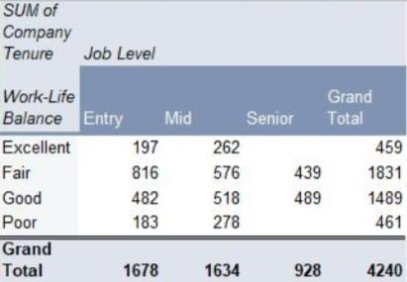
RESULT
1.PIVOT TABLE
13

Slide 14
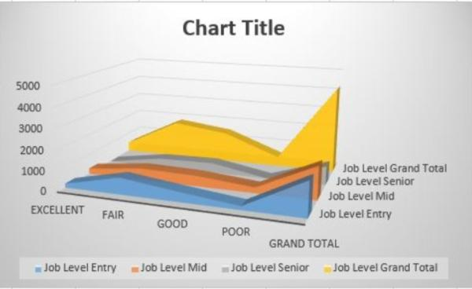
2.FLOW CHART

Slide 15
conclusion
In conclusion, our employee performance analysis solution is a game-changer for businesses looking to optimize remote worker productivity. By providing real-time, personalized feedback and coaching recommendations, we're empowering workers to take ownership of their performance and drive business outcomes. With its Al-powered analysis, user-friendly dashboard, and seamless integration with existing HR systems, our solution is the perfect tool for businesses looking to stay ahead of the curve in the new normal of remote work

